Slide 1


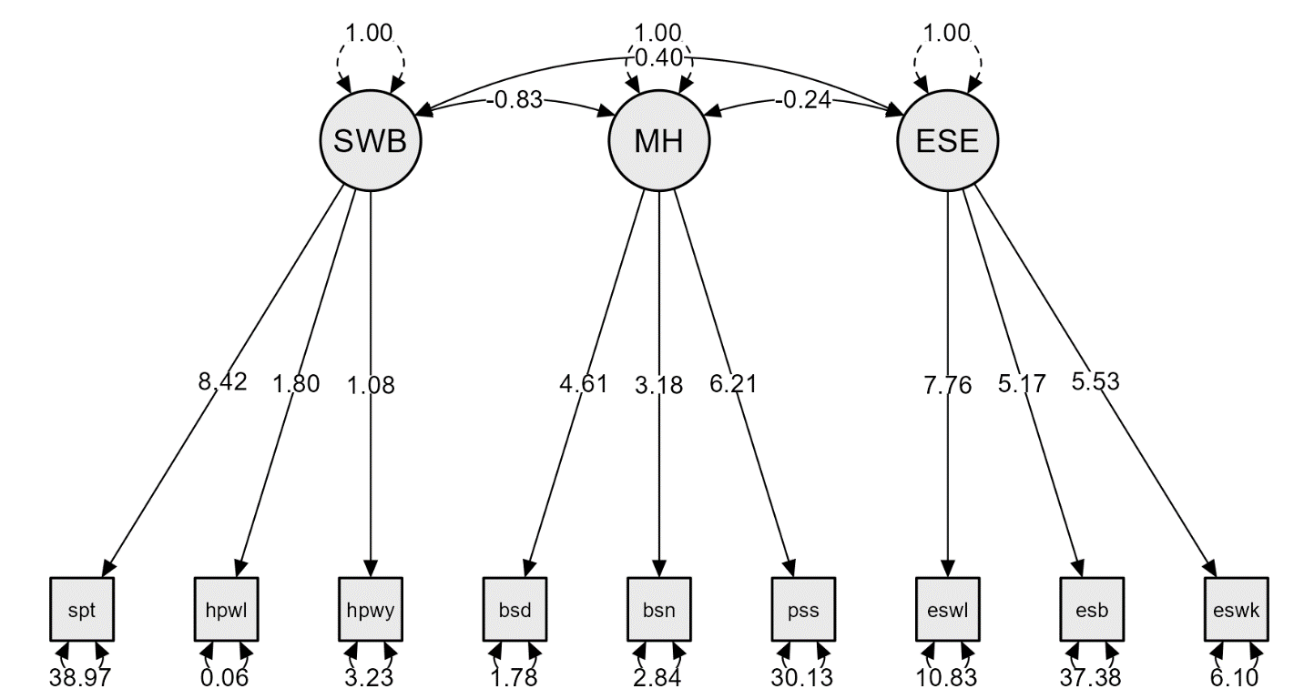
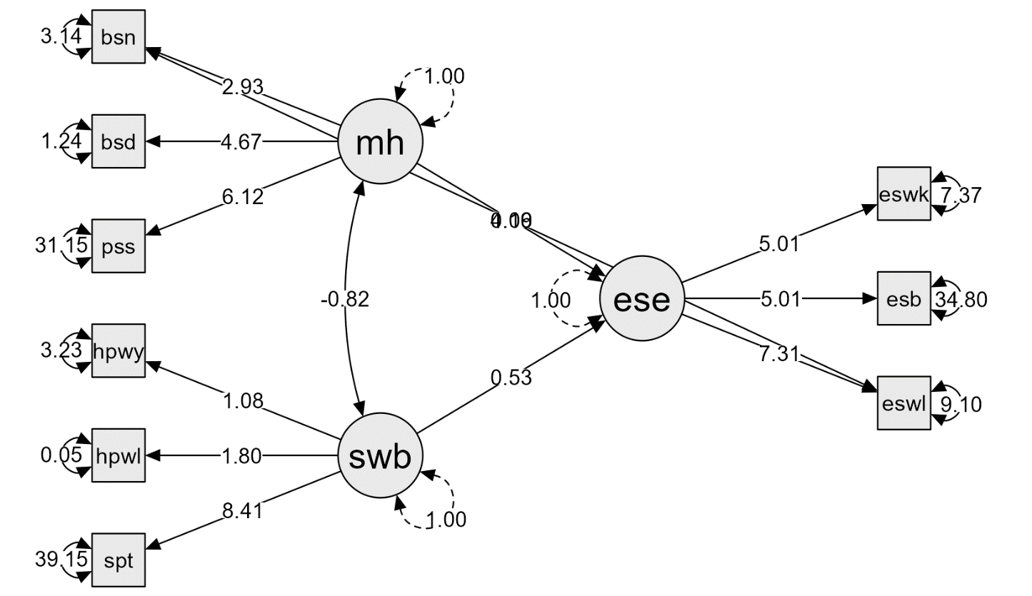
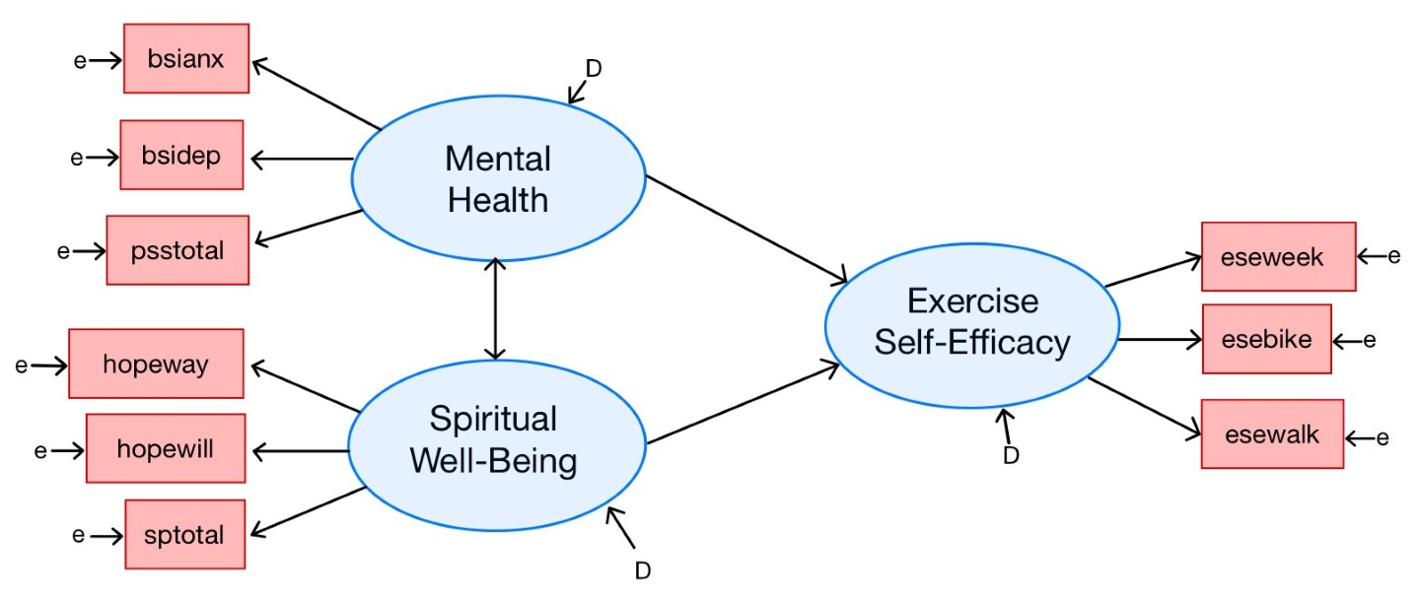
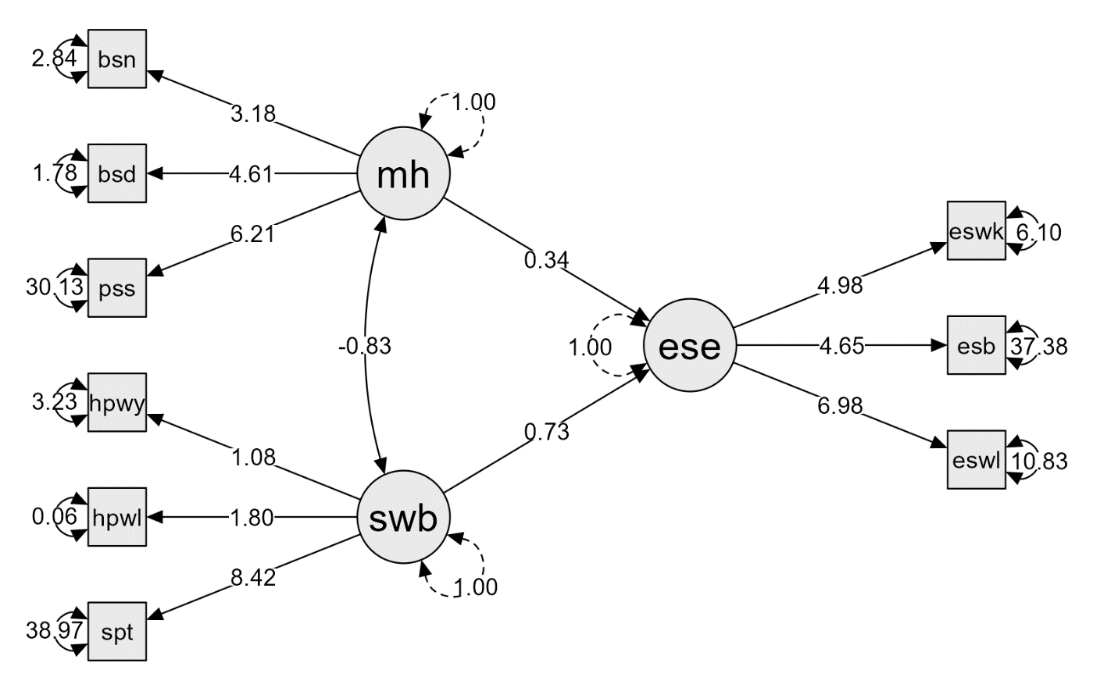

One Step at a Time: Exercise Self-Efficacy in Cancer Survivors
B.L. Scheuler¹, J.W. Houpt¹, and D.C. Hughes²
¹The University of Texas at San Antonio ²The University of Texas Health Science Center at San Antonio
Introduction
Confirmatory Factor Analysis
Alternative Model
One of the many challenges cancer survivors face is relapse prevention. While there is substantial research illustrating that exercise is a crucial component of preventing cancer relapse (Magné et al., 2011), the effects of treatment can make exercise feel daunting. The first step to overcoming this difficulty is understanding what factors contribute to cancer survivors’ exercise self efficacy. To build our understanding of these factors, we utilized factor analysis and structural equation modeling to evaluate potential factors in a sample of 29 breast cancer survivors.
Measurements
- Functional Assessment of Chronic Illness Therapy- Spiritual Wellbeing
- Adult Hope Scale
- Willpower subscale
- Waypower subscale
- Perceived Stress Scale
- Brief Symptom Inventory-18
- Depression subscale
- Anxiety subscale
X Somatization subscale
-Exercise Self-Efficacy Scale
Model Fit
Chi-Square: X²(24, N = 29) = 33.17, p = 0.10
CFI: 0.95
RMSEA: 0.12 (0.00, 0.20)
SRMR: 0.09
There is significant covariance between mental health and spiritual well-being, but less evidence of covariance of each factor with exercise self-efficacy, so we proceeded with analysis
JASP provides suggestions to improve model fit, and the top suggestion was to account for residual covariance between esewalk’ and ‘bsianx.’ If this significantly improved the model, we would need to consider the theoretical implications. From this suggestion, we created an alternative model.
Model Fit
Chi-Square: X²(23, N = 29) = 25.93, p = 0.30
CFI: 0.98
RMSEA: 0.07 (0.00, 0.17)
SRMR: 0.08
14% of the variance in exercise self-efficacy was explained by the model
Covariance and direct effects remained nearly the same
Use SEM to understand what factors increase survivors’ exercise self-efficacy
Design treatments aimed at underlying factors to improve exercise self-efficacy
Decrease cancer relapse
Structural Equation Modeling
Model Fit
Chi-Square: X²(24, N = 29) = 33.17, p = 0.10
CFI: 0.95
RMSEA: 0.12 (0.00, 0.20)
SRMR: 0.09
19% of the variance in exercise self-efficacy was explained by the model
There was significant covariance between spiritual well-being and mental health
The direct effect of spiritual well-being on exercise self-efficacy approached significance, but this trend did not hold for mental health and exercise self-efficacy
Discussion
But which model is preferred?
∆X²(1, N = 29) = 7.24, p = 0.007
BF₂₁ = 6.96 (from BICs)
Is the increased model fit worth the loss of degrees of freedom?
There is also a trade-off between model fit and explained variance in exercise self-efficacy
Most importantly, there is no theoretical basis for including a residual covariance between the ESE-walk subscale and BSI-anxiety subscales
Proposed Model
Future Directions
There are many potential next steps for this project:
Utilizing a larger sample size
Including additional factors, such as social support
Exploring different measurement tools
Performing a longitudinal analysis during an intervention
For references, syntax, and more, please see QR code.
Note: For item means, standard deviations, and reliability, as well as assumption checks (e.g., Bartlett’s test and KMO measures), please see the online supplemental material.

